Slide 1

Deep Learning based Spatio-Temporal Anomaly Detection in Videos
CS5330 Sp24
Team members:
Ravi Shankar Sankara Narayanan
Haritha Selvakumaran
Vishaq Jayakumar

Slide 2
Introduction
Anomaly detection in video streams is a critical task with applications in surveillance, industrial monitoring, etc.
Traditional methods struggle to capture complex spatio-temporal patterns in video data
In this project we explore how deep learning-based solution can capture these patterns and effective detect anomalies in images and video files.

Slide 3
Methodology
We use the DCSASS dataset for this anomaly detection problem
1
The dataset cannot be readily used for training, we extract the images and it’s respective labels
2
Two DL models are explored for training the dataset
3
A 3D CNN model defined from scratch and transfer learning using MobilenetV2 model are used for training
4
Lastly, we compare the results of both the model
5

Slide 4
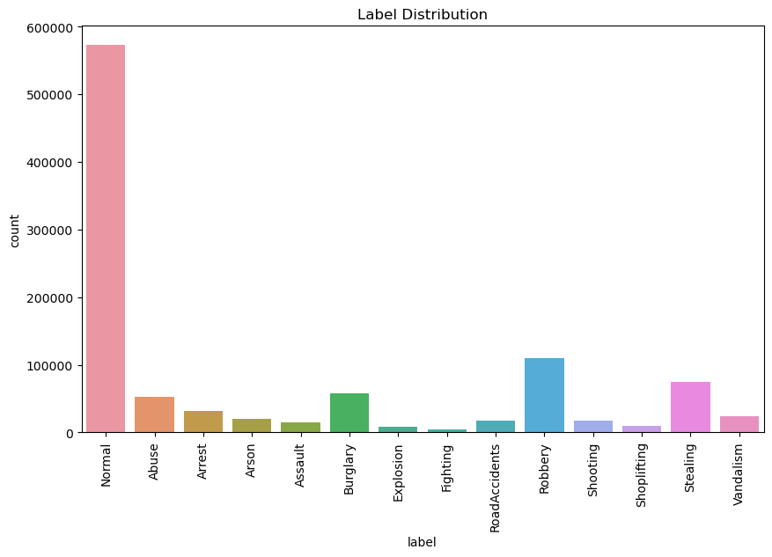
Data Extraction & analysis
The DCSASS dataset has 14 classes where 13 classes are anomaly events like theft, assault, shooting and one is normal.
We first extract the images from these video files and map them to their respective labels. In total there were around 1 million images with labels.
The distribution of label is represented in the chart

Slide 5
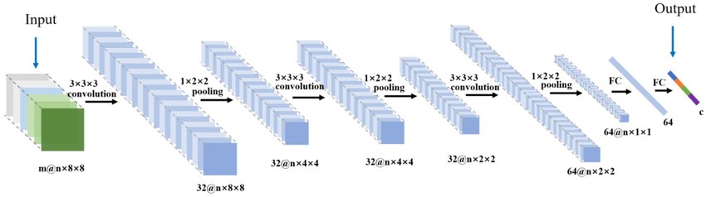
3D-CNN
3D Convolutional Neural Networks (3DCNNs) extend traditional CNNs to process spatiotemporal data, such as videos.
Multiple convolutional layers process three-dimensional input volumes, capturing both spatial and temporal features.
Widely used in video analysis tasks, including action recognition and anomaly detection in surveillance videos.

Slide 6
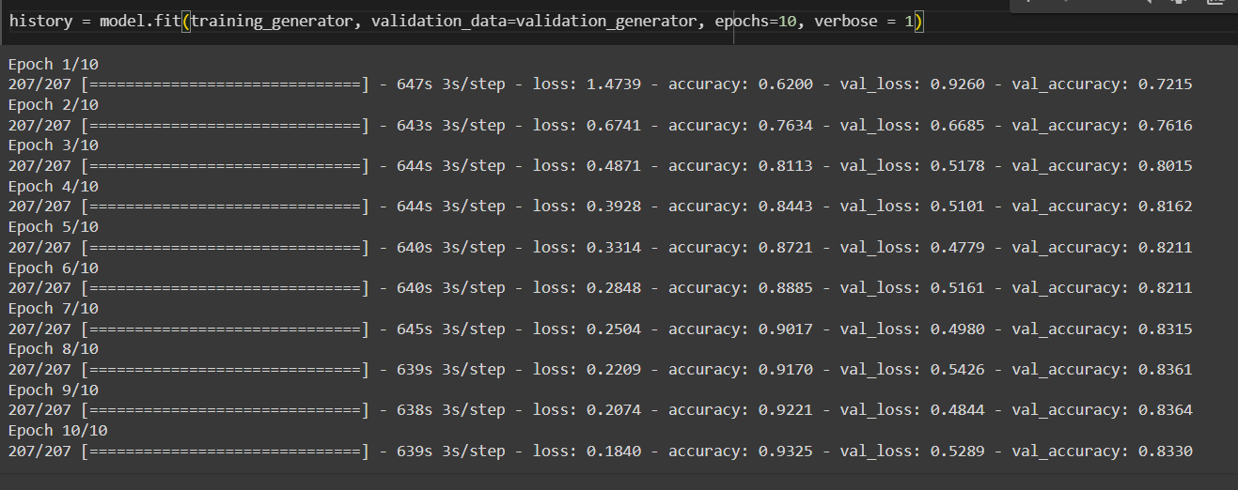
3D-CNN
The model is compiled using the categorical cross-entropy loss function, which is suitable for multi-class classification tasks.
The Adam optimizer is chosen for its efficiency in training deep neural networks
Evaluation metrics such as accuracy are specified to monitor model performance during training.

Slide 7
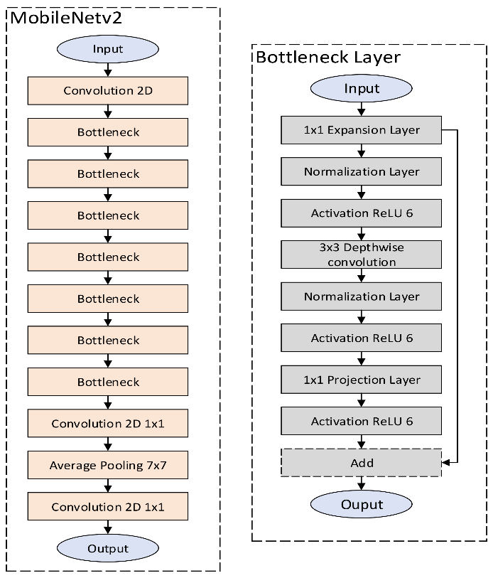
Mobilenetv2
MobileNetV2 is a highly efficient convolutional neural network architecture that is optimized for mobile and embedded vision applications.
The base model with the ImageNet weights is used for transfer learning. The model has 154 layers and 2257984 parameters
This model posses features like linear bottlenecks and inverted residuals that allows the model to be more efficient without sacrificing accuracy.

Slide 8
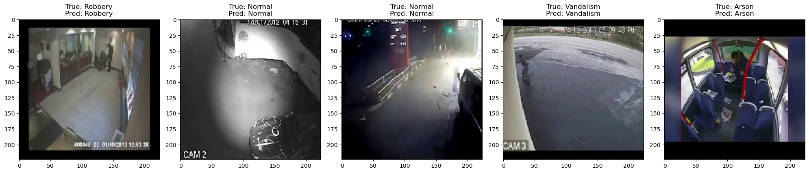
Results
The model took almost 6-7 hours to train and achieved 98% accuracy on the test data

Slide 9
Conclusion and Future WORK
On comparing the performance of both the models we can observe that the MobileNetV2 performs better than 3D CNN
Our next goal would be to use this model to detect if the input frames from a video is anomaly or not in real-time. With the current hardware we have, real-time detection seems to lag a lot generating 1-2 frames/second.

Slide 10

Thank You

